Slide 1
Agile software development (3 Hrs.)
Unit 3
Prepared by: Natabar Khatri
New Summit College

Slide 2
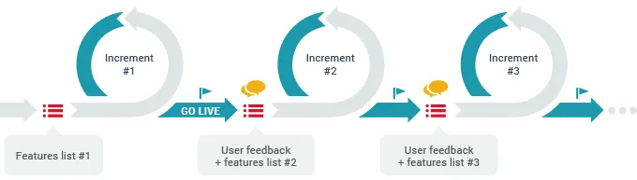
Agile Development
Agile methods emerged in the late 1990s as a response to the limitations of traditional, plan-driven software development approaches.
The term agile refers to being able to move quickly and easily. It also refers flexibility and the willingness and ability to change and adapt.
The Need for Agile Development
In today's fast-paced business environment, organizations face:
Global competition requiring rapid response to market changes
Evolving customer needs that make fixed requirements impractical
Pressure to deploy software quickly, often prioritizing speed over perfection

Slide 3
Agile Development
Common Characteristics of Agile Development
Interleaved Activities
Specification, design, and implementation occur simultaneously
Minimal upfront documentation (focus on working software)
The user requirements document is an outline definition of the most important characteristics of the system.
Incremental Delivery
Small, frequent releases (typically every 2-3 weeks)
Stakeholders evaluate and refine requirements iteratively
Customer Collaboration
End-users actively participate throughout development
Feedback directly shapes future iterations
Extensive tool support is used to support the development process. Tools that may be used include automated testing tools, tools to support configuration management, and system integration and tools to automate user interface production.

Slide 4
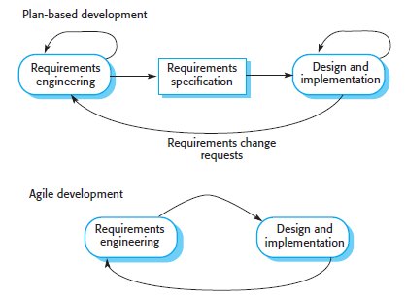
Plan-driven vs. agile development
In plan-driven methods (e.g., Waterfall, V-Model), iteration occurs within individual stages of the process, with formal documents acting as handoffs between phases.
Agile methods (e.g., Scrum, XP) blend requirements, design, and implementation into cross-functional iterations (sprints).

Slide 5
Plan-driven vs. agile development
Plan-Driven Process Structure
Agile Process Structure
Linear phase execution:
Requirements → Design → Implementation → Testing → Maintenance
Iteration occurs within phases
Formal documents transition between stages
Changes trigger phase rework
Cyclic sprints (typically 2-4 weeks)
Cross-functional iteration:
Requirements refinement
Design adjustment
Implementation
Testing
Continuous integration
Regular stakeholder feedback

Slide 6
Plan-driven vs. agile development
When to Use Each
Plan-Driven excels when:
Requirements are stable and well-understood
Regulatory compliance demands documentation • Large-scale systems integration required
High consequence of failure (e.g., medical devices)
Agile excels when:
Requirements are uncertain or volatile
Rapid time-to-market is critical
Customer feedback is essential
Innovation and experimentation needed

Slide 7
Agile Methods
Why Agile Methods Were Developed
Dissatisfaction with Heavyweight Processes
Traditional plan-driven methods (e.g., Waterfall) required extensive upfront planning, detailed documentation, and strict phase completion before moving forward.
This led to slow development cycles, high overhead costs, and difficulty adapting to requirement changes.
Need for Faster, More Responsive Development
Businesses demanded quicker software releases to stay competitive.
Agile methods enabled incremental delivery, allowing teams to release functional software in weeks rather than years.

Slide 8
Agile Methods
Shift in Development Priorities
The Agile Manifesto (2001) redefined success by valuing:
Individuals and interactions over processes and tools
Working software over comprehensive documentation.
Customer collaboration over rigid contract negotiation.
Responding to change over following a fixed plan.

Slide 9
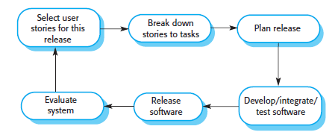
Agile Methods
The Agile Process in Practice
Fig: The XP release cycle

Slide 10
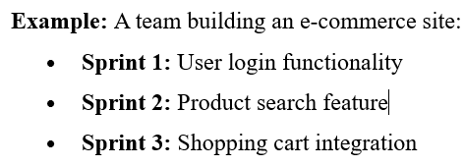
Agile Methods
The Agile Process in Practice
Select User Stories
Prioritize features for the next release (e.g., "As a user, I want to reset my password").
Break Down Tasks
Divide stories into actionable items (e.g., design UI, implement backend logic).
Plan the Release
Define sprint goals and timelines.
Develop, Integrate & Test
Code, merge changes, and run automated tests daily.
Evaluate & Release
Demo to stakeholders, gather feedback, and deploy.

Slide 11
Agile development techniques
Agile development revolutionized software engineering by shifting focus from rigid, documentation-heavy processes to flexible, iterative, and collaborative methods.
Among these, Extreme Programming (XP) emerged as one of the most influential frameworks, pushing agile principles to their limits to maximize efficiency and adaptability.
Core Principles of Extreme Programming (XP)
XP is built on practices that emphasize rapid delivery, continuous feedback, and high code quality. Extreme programming embraces the idea of pair programming and test-driven development.
Incremental Development via Small Releases
Continuous Customer Involvement
People-Centric Development
Embracing Change
Simplicity in Design

Slide 12
Agile development techniques
1. Incremental Development via Small Releases
User Stories: Requirements are captured as simple, customer-centric scenarios (e.g., "As a user, I want to reset my password").
Frequent Releases: Instead of waiting months for a final product, XP teams deliver working increments in days or weeks.
Prioritization: Features are selected based on business value and feasibility, ensuring the most critical functions are developed first.
Example: A team building an e-commerce site releases a basic product listing first, then iteratively adds a shopping cart, checkout, and payment processing.

Slide 13
Agile development techniques
2. Continuous Customer Involvement
On-Site Customer: A dedicated customer representative works full-time with the development team to clarify requirements and validate features.
Acceptance Testing: The customer defines test cases to ensure the software meets real-world needs.
3. People-Centric Development
Pair Programming: Two developers work together on one machine—one writes code while the other reviews in real-time.
Collective Ownership: No single developer "owns" a module; anyone can modify any part of the codebase.
Sustainable development Process: Avoids burnout by discouraging excessive overtime, ensuring long-term productivity.

Slide 14
Agile development techniques
4. Embracing Change
Test-First Development (TDD):
Write automated tests before coding.
Ensures code meets requirements from the start.
Refactoring: Continuously improve code structure without changing functionality to maintain simplicity.
Continuous Integration (CI):
New code is integrated and tested multiple times a day.
Catches integration issues early.
5. Simplicity in Design
YAGNI ("You Aren’t Gonna Need It"): Avoid over-engineering by only coding for current requirements, not hypothetical future needs.
Minimal Documentation

Slide 15
Agile Project management
An approach to project and team management based on Agile Manifesto.
The Manifesto is a collection of four values that define the mindset that all Agile teams should strive for.
provides a structured yet flexible approach to software development that aligns with Agile principles while addressing the need for project visibility and control.
Core Principles of Agile Project Management
Agile project management emphasize:
Iterative progress through short development cycles (sprints).
Self-organizing teams with collective ownership.
Continuous stakeholder collaboration (e.g., Product Owner involvement).
Adaptability to change over rigid long-term planning.

Slide 16
Agile Project management
The Scrum Framework
Scrum is the most widely adopted Agile project management method.
It structures work into fixed-length iterations (sprints) and defines clear roles, artifacts, and ceremonies.
1. Key Roles
Role | Responsibilities
Product Owner | - Represents stakeholders/customers. - Prioritizes the Product Backlog. - Defines acceptance criteria.
Scrum Master | - Ensures Scrum practices are followed. - Removes obstacles for the team. - Facilitates daily stand-ups.
Development Team | - Self-organizing group (5–9 members). - Delivers a potentially shippable increment each sprint.

Slide 17
Agile Project management
2. Scrum Terminology
Product Backlog : Prioritized list of features, user stories, and tasks.
Sprint Backlog: Subset of Product Backlog items selected for a sprint. Broken into actionable tasks.
Increment: Working software delivered at the end of each sprint (potentially shippable).
Sprint: A development iteration. Sprints are usually 2 to 4 weeks long.

Slide 18
Agile Project management
3. Scrum Events
Event | Purpose
Sprint Planning | Team selects backlog items for the sprint and breaks them into tasks.
Daily Scrum | 15-minute stand-up to sync progress ("What I did, what I’ll do, blockers").
Sprint Review | Demo of the increment to stakeholders for feedback.
Sprint Retrospective | Team reflects on improvements for the next sprint.

Slide 19
The Scrum Process (Sprint Cycle)
Product Backlog Refinement
The Product Owner prioritizes features, user stories, and technical tasks.
Items are refined for clarity (e.g., "As a doctor, I want dose-checking to prevent errors").
Sprint Planning
The team selects high-priority items from the backlog.
Tasks are estimated (story points/hours) based on velocity (past sprint performance).
Sprint Execution (2–4 weeks)
Developers work on tasks in a self-organized manner.
Daily Scrums keep the team aligned.
Sprint Review & Retrospective
Stakeholders review the increment and provide feedback.
The team identifies process improvements.
Repeat
Unfinished work returns to the backlog.
The next sprint begins with updated priorities.

Slide 20
Agile Project management
Benefits of Scrum
✔ Transparency – Progress is visible through sprint reviews and daily stand-ups. ✔ Flexibility – Requirements can be reprioritized between sprints. ✔ Faster Feedback – Stakeholders see working software frequently. ✔ Improved Team Morale – Self-organization fosters ownership and collaboration.

Slide 21
Agile Project management
Challenges & Adaptations
1. Distributed Scrum (Remote Teams)
Solutions:
Daily video stand-ups for alignment.
Shared tools (Jira, Trello) for backlog tracking.
Continuous Integration (CI) to sync code changes.
2. Scaling Scrum
Large Projects: Use frameworks like SAFe or LeSS to coordinate multiple Scrum teams.
Hybrid Models: Combine Scrum with Kanban (Scrumban) for continuous flow.
3. Role Confusion
Scrum Master ≠ Project Manager – Focuses on process, not task assignments.
Product Owner ≠ Business Analyst – Must have decision-making authority.

